Slide 1

SRM INSTITUTE OF SCIENCE AND TECHNOLOGY Ramapuram, Chennai – 600 089 SCHOOL OF COMPUTER SCIENCE AND ENGINEERING DEPARTMENT OF COMPUTER SCIENCE AND ENGINEERING
21CSC205P/Database Management Systems
Final Review
Banking Management System
BATCH NUMBER : 2
Team Members | Supervisor
Vishnu G – RA2311030020034 T S Harish - RA2311030020047 D R Seshaathri – RA2311030020052 | NAME: Visnu Dharsini S, M.E., Ph.D, Assistant Professor, CSE

Slide 2
AGENDA
Introduction
Abstract
Scope and Motivation
Objectives
ER diagram
Architecture diagram
Front end design
Backend database
Db connectivity
Result and discussion
Applications
Conclusion
References

Slide 3
INTRODUCTION
The system efficiently manages banking operations.
A structured interface allows the users to navigate customers and admin functions with ease.
Secure login is ensured through SHA-256 hashed pin authentication.
Admins can manage user accounts and monitor transaction records.

Slide 4
ABSTRACT
The system is built using Python and SQL for efficiency.
A database-driven approach ensures structured data management.
User authentication enhances security for login and transactions.
The platform streamlines order processing and payments.

Slide 5
SCOPE AND MOTIVATION
The system enables customers to perform banking operations conveniently through an intuitive.
Admins can manage the users accounts, transactions and over all system settings.
Secure authentication and encryption ensure safe access and protect data.
The interface is designed to be simple and user-friendly.

Slide 6
OBJECTIVES
Develop a system to efficiently manage banking operations services.
Enables smooth handling of transactions, account management, and fund transfers.
Ensure data consistency and security using a database-driven approach.
Provide a user-friendly interface for customers and admins.

Slide 7
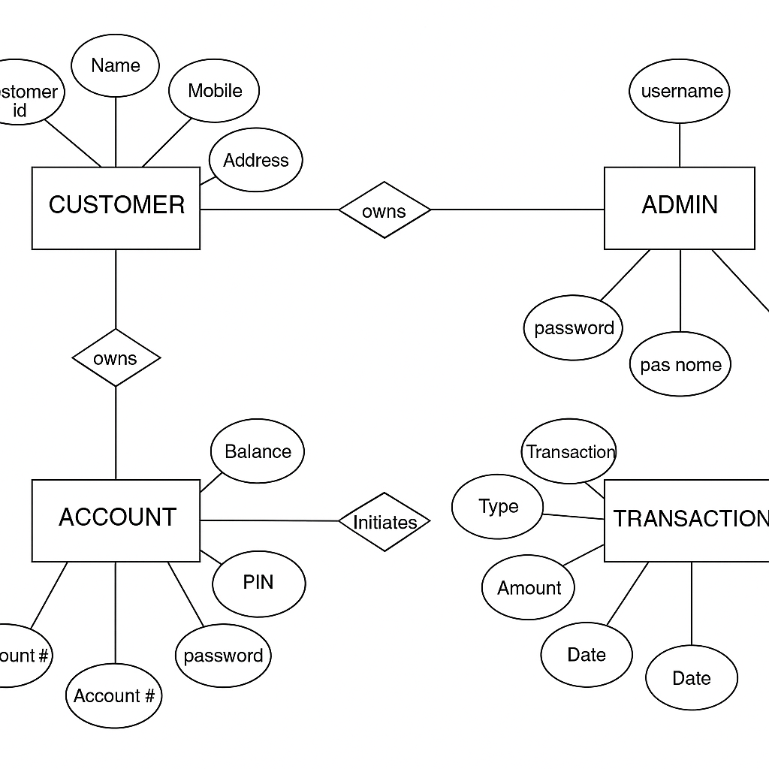
ER DIAGRAM

Slide 8
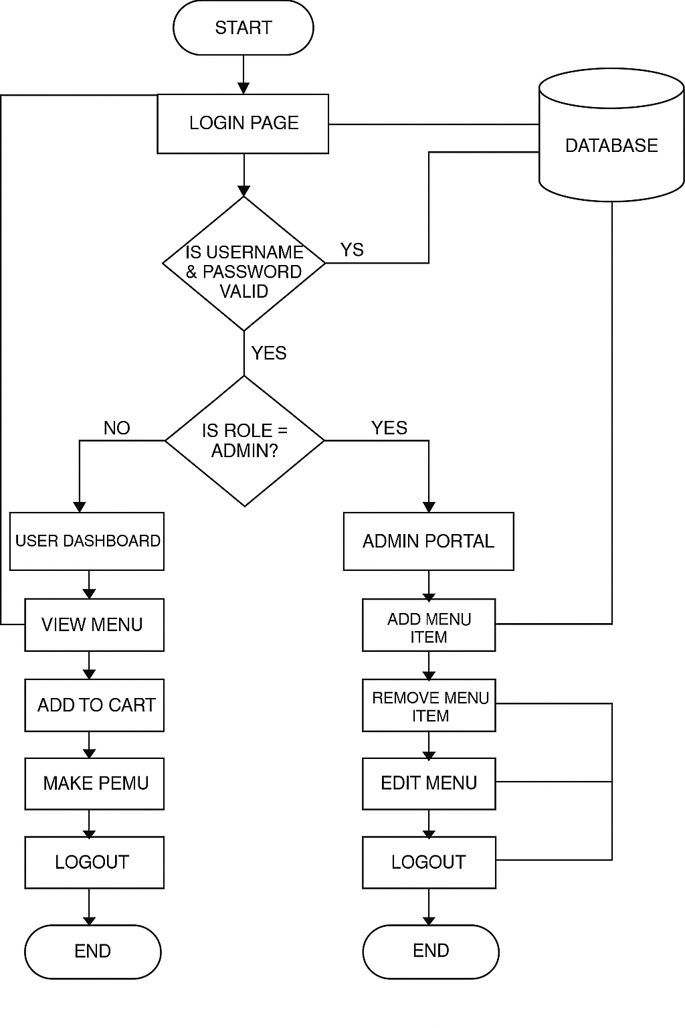
ARCHITECTURE DIAGRAM

Slide 9
TOOLS TO BE USED
SQL is used for database management and storage.
Python handles backend logic and system integration.
A secure payment gateway ensures safe transactions.

Slide 10
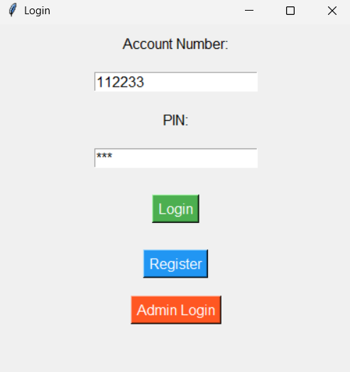
FRONTEND DESIGN – LOGIN PAGE

Slide 11
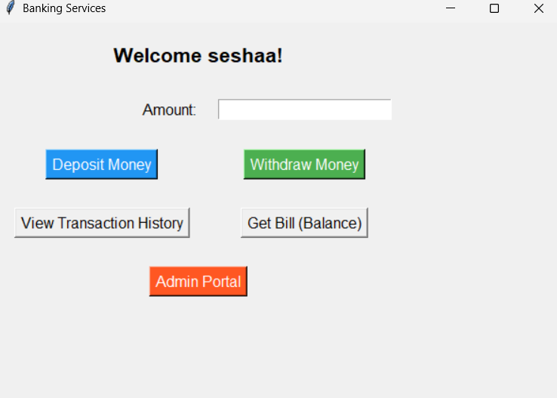
FRONTEND DESIGN - MENU

Slide 12

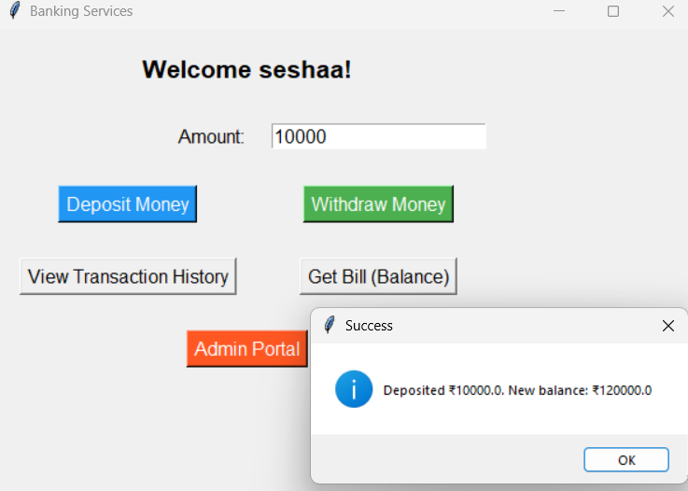
FRONTEND DESIGN - DEPOSIT

Slide 13
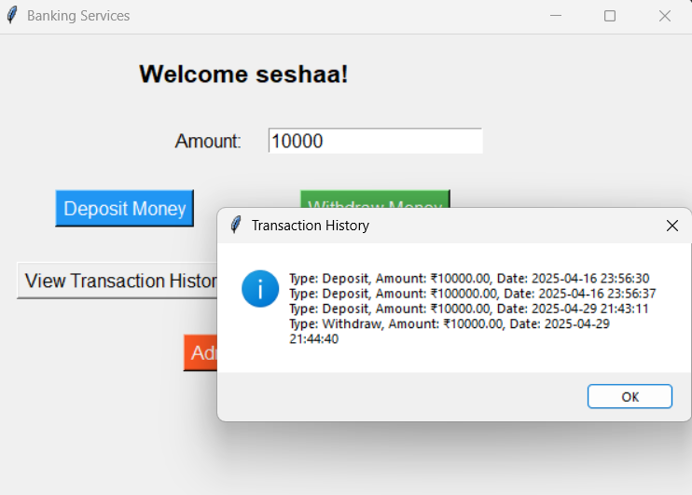
FRONTEND DESIGN – TRANSCTION HISTORY

Slide 14
BACKEND DATABASE
Uses MySQL as the backend relational database.
Database schema includes tables for admins, accounts transactions and users.
Designed to store user credentials, users information, login password and transactions history data.
Structured using SQL script (bank.sql) for consistent setup.
Enables structured storage and efficient querying of restaurant-related information

Slide 15

DATABASE CONNECTIVITY
Python scripts use MySQL Connector for database communication.
Functions include connect() to establish a connection using credentials.

Slide 16
RESULT AND DISCUSSION
The SQL creates the tables and creates the row and columns .
SQL scrips allows the SQL command line to create the following tables in SQL database.
Demonstrates seamless interaction between frontend inputs and backend storage.
Achieved reliable CRUD operations (Create, Read, Update, Delete).
Ensured system responsiveness with minimal runtime errors.

Slide 17
APPLICATIONS
Customers can browse the menu and place orders.
Admins have control over menu items and restaurant settings.
Users must register and log in for a personalized experience.
Payments are processed securely to complete transactions.

Slide 18
CONCLUSION
Project successfully integrates Python backend with MySQL database.
Secure admin login and menu management achieved.
Demonstrated effective database communication and data handling.
Code is modular, maintainable, and expandable for future features.
Lays the foundation for a complete restaurant management system.

Slide 19
REFERENCES
Smit Patel's RMS Project – Comprehensive documentation covering project profile, tools, ER diagrams, and more.
Maruf Abdullah's RMS Presentation – Focuses on enhancing efficiency in restaurant operations through software solutions.
Juliasmith1985's RMS Overview – Discusses the shift from traditional methods to modern POS systems in restaurants.
Deliveroo's Technological Integration – Highlights how Deliveroo aids restaurants in modernizing operations and improving efficiency.
SlideTeam's RMS Slides – Offers detailed slides on implementing RMS, covering aspects like POS, inventory, and staff management.

